Slide 1
Scientific Programming in Python
NDP Mini-course
Matt Budde, PhD
Aug 27-28 2025

Slide 2
Mini-course Outline
Intro to python: why, installation, how to, …
Python language basics (jupyter notebook)
Variables, conditional statements, loops, functions, imports, etc…
Example problems
Python for figures
Getting started for yourself

Slide 3
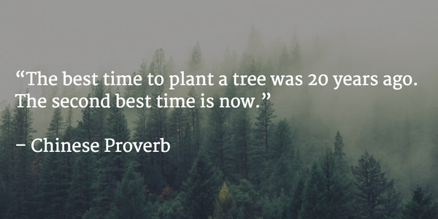

Slide 4
Getting started in the lab:
Like most other things, programming is a tool to help your science.
Use it to do what you need/want to get done.
- Accelerate tasks that you would otherwise do slower/manually.
- Alter code to achieve things that it currently doesn’t.
Find a task in the lab you think is feasible to accomplish in a few hours or days.
Choose something that will actually help you, not simply something as a tutorial.
Pick something with a definite endpoint; not just didactic learning.
Do not write from scratch! Steal, borrow, beg, for similar code that you can modify.
Examples,
Convert formatted files from other programs (behavior, flow cytometry, etc..) into a single dataset for statistical analysis
Replacing cut/paste steps in other programs (Excel)
Create and re-create figures from data.
Other options…
ChatGPT-> start using it, now!

Slide 5
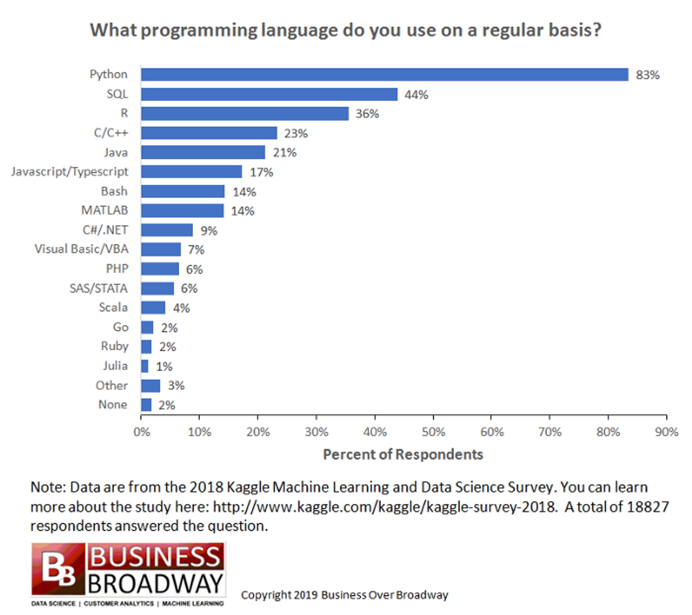
Why python?
Popularity
Broadly used in scientific programming.
Very easy to get started
Ample resources
Many may have already used it.
Why not python?
slow(er)
Not ideal for computationally-intensive tasks
Many versions/variants, decentralized

Slide 6
Programming in python
Jupyter-(lab/notebook): browser-based tool to run scripts and portions of scripts
Very useful & intuitive to get started
Not as easy for efficient programming (non-interactive programs)
Interactive development environment (IDE): software to assist programming, running code, debugging, etc
Useful for more intensive tasks
Typically programs that access files or run for longer times.
Visual Studio Code (VSCode) is a popular choice

Slide 7
Python concepts
Python is the main programming language
Packages are tools written in python by others (pandas, matplotlib, numpy):
Installed using pip (python package installer): pip install matplotlib
Used in your code by importing:
import matplotlib #for the whole package
from matplotlib import plot #for just some function/part of package
Because code/programs rely on certain versions, a set of packages can be created into an ‘environment’.
Python code is executed through a ‘kernel’ or python version
In jupyter, select a kernel with a given or default environment
On your computer, a terminal is typically used to run a program: python DoSomething.py
The high degree of flexibility/customization can often be a challenge for users (new and experienced).

Slide 8
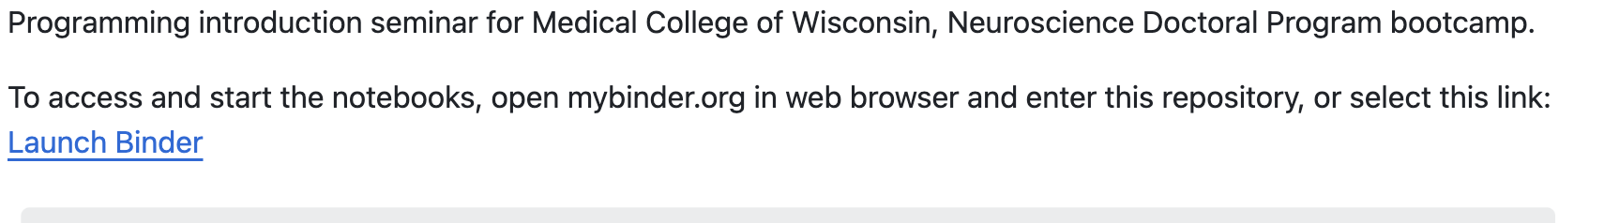
https://github.com/mdbudde/NDPprogramming
Start Notebook Here
For this bootcamp, all files are saved in a github repository and loaded into a web-based program (binder) to run.
Files can be edited, but changes will not be saved back to the main files, so edit and program with them to learn and develop.
Later I will show you how to get started with your own coding setup (vscode).

Slide 9
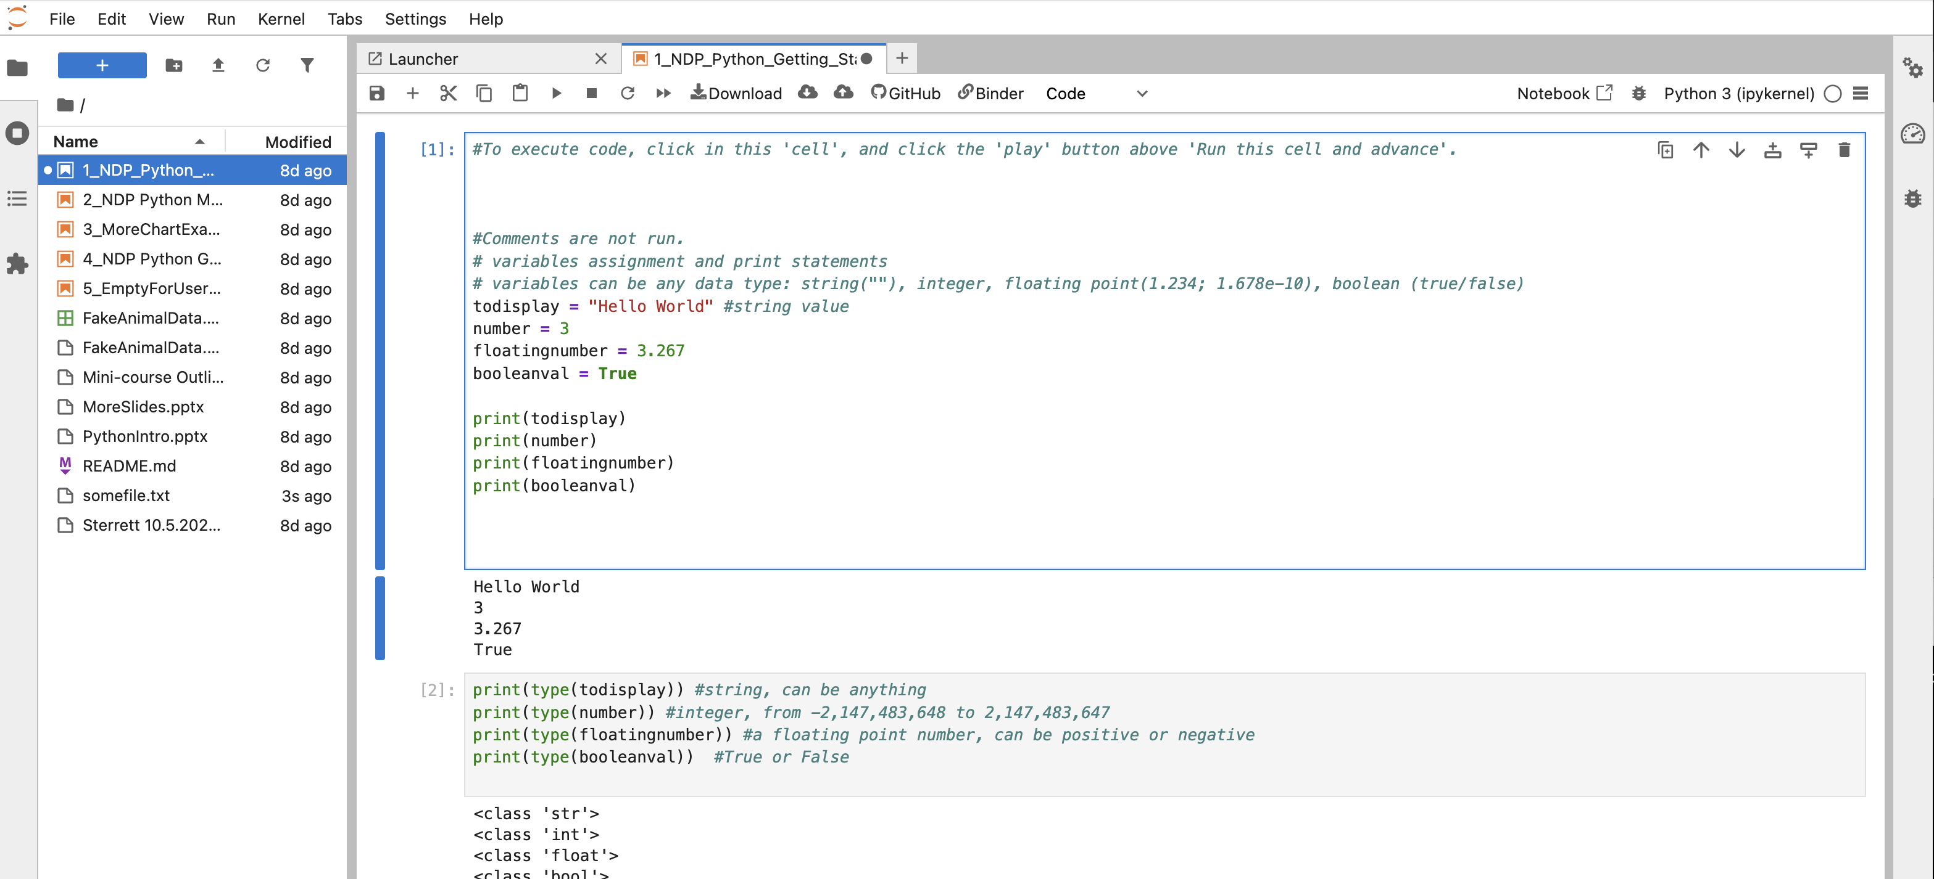
Jupyter notebook: Step-by-step running code snippets
run
computer/kernel
Code editor
output

Slide 10
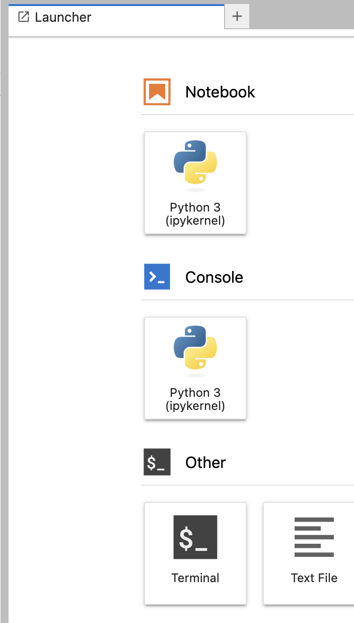
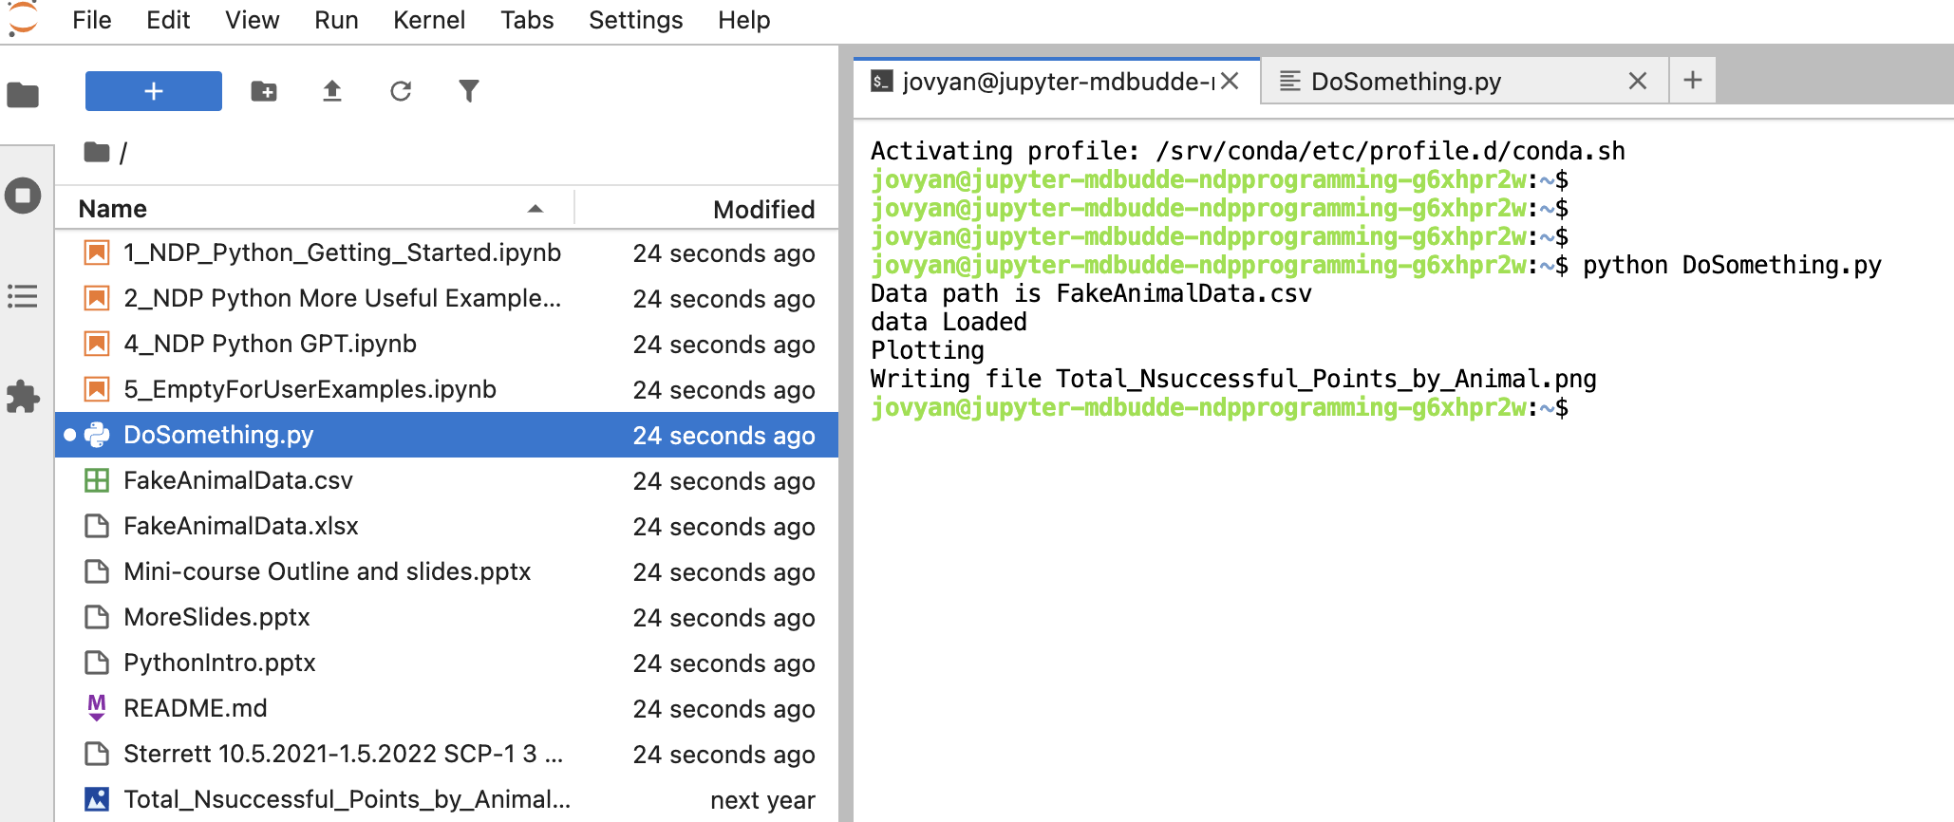
Terminal: running a script all-at-once
In terminal, type: python DoSomething.py will run the file/script

Slide 12
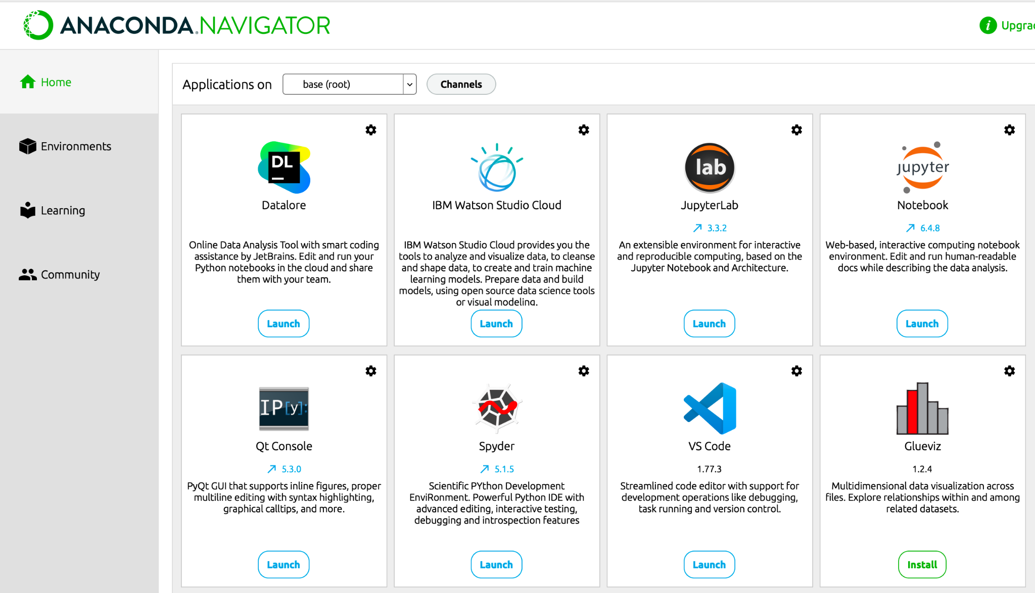
Using/installing python
Use an installer such as Anaconda
Interfaces with several software packages
Jupyter (lab/notebook)
VS Code

Slide 13
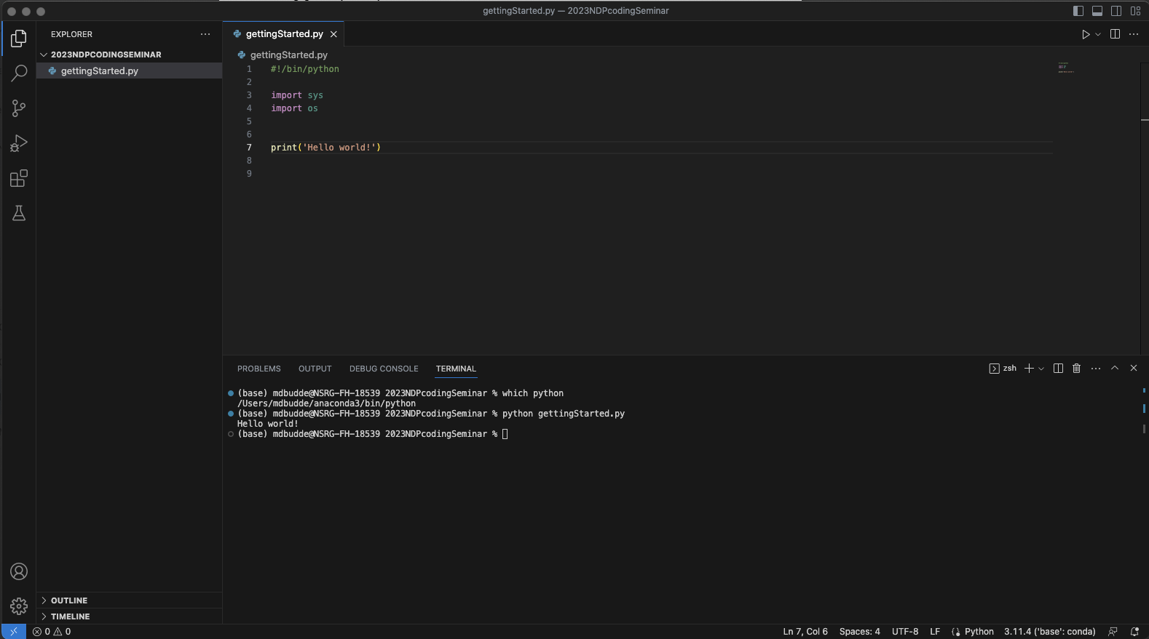
IDE: Visual Studio Code
editor
File browser
terminal

Slide 14
Saving, Documenting, Sharing
Maintain good laboratory practices for storing and documenting code.
Reproducibility is key, be able to re-run the same code.
How to store code:
Most often, store it with the data to be processed (always backup!)
Repositories (github) are useful for collaborating & versioning.
Example: https://github.com/mdbudde/NDPprogramming
Just get started, but routinely consider workflow and ways to improve.

Slide 15
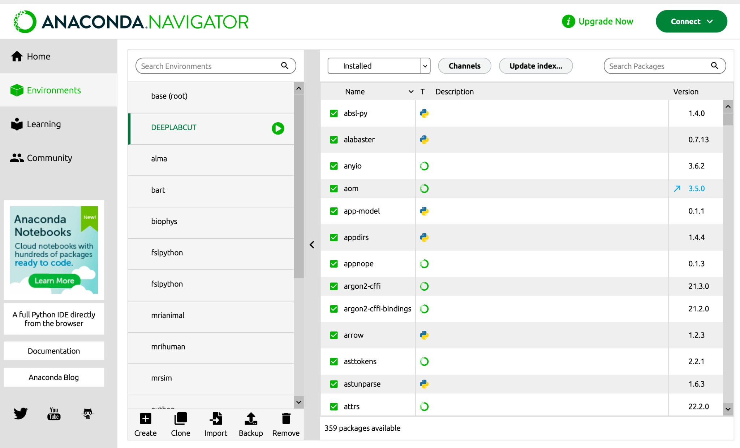
Anaconda example
Conda maintains different environments
Avoids conflicts and keeps versions organized
For example, DeepLabCut was developed with specific package versions.
Other code likely use different packages and versions of the same package.
Especially in python, versions matter.
pip: Python package installer

Slide 16
